Slide 1
rtos
Introduction

Slide 2
Basic concepts

Slide 3
Concepts: Events, classifications
Event
An occurrence that changes program flow non-sequentially
Event classification 1
Event classification 2
Deterministic system
For each possible state and input, a unique output and next state can be determined
Synchronous events | Asynchronous events
Occur at predictable times In sync with code | Occur at unpredictable times Not in sync with code
Periodic events | Aperiodic events | Sporadic events
Repeat at precise, regular times | Repeat, but not at regular periods | Appear infrequently, at irregular times

Slide 4
Concepts: Events – Examples
 | Periodic | Aperiodic | Sporadic
Synchronous | - Cyclic code - Processes scheduled by internal clock | - Branches - Jumps - Garbage collection | - Error recovery code - System calls
Asynchronous | - Clock generated interrupt | - Regular interrupt with no fixed period | - Externally generated interrupt

Slide 5
Concept: System utilization
The percentage of usage of a system / resource
Indicates buffers available for handling excursions
Utilization (%) | Category | Application(s)
0-25 | Excess resources | -
26-50 | Very safe | High consequence system
51-68 | Safe | Critical system
69-70 | Theoretical limit | Average system
71-85 | Questionable | Overloaded system
86-100+ | Dangerous | Stressed system

Slide 6
System design – Issues and dimensions
System specification
Form factor
Operating environment
Temporal behavior
Selection of HW and SW components
Hardware
Cost, availability, manufacturability
Software
Programming language and development nuances
System testability
System interoperability (standards compliance)
System fault tolerance requirement
System reliability

Slide 7
Concept: Real-time systems
Systems defined by constraint(s) on
Event to System-response time
Systems that guarantee response
Within specified time constraints (called ‘deadlines’)
Formal definition
A real-time system is one which controls an environment by receiving data, processing it, and returning the results sufficiently quickly to affect the environment at that time
Usually used for mission-critical, high-consequence systems

Slide 8
Concept: RTOS
A real-time operating system (RTOS) is an OS
Intended to serve real-time applications on real-time systems
Prime characteristics:
High level of consistency regarding time taken to complete a task
Low ‘jitter’ – variability in response time
Deadlines met deterministically by proper task scheduling
Minimal interrupt and thread-switching latency
Hard vs Soft real-time
Hard real-time: Late response is a ‘wrong’ response
Soft real-time: Late response can be tolerated within limits

Slide 9
Real-time systems: Misconceptions
Real-time systems are ‘fast’ systems
Real-time task scheduling is a solved problem
There are universal methodologies for real-time system specification and design
Using a well-known commercial real-time OS is enough to make real-time products

Slide 10
Real-time world - a glimpse into issues

Slide 11
RT issues: Strange problem
Assembly plant
Temperatures change at different places
Monitoring system
Equipped with 2 temperature sensors
At different places in an assembly plant
Sensors give interrupts when they have temperature data
Monitors if the 2 temperatures are equal
Raise an alarm if they are not!
System deployed, strange observation:
As temperatures changed in the plant
Even if the temperature at all places was equal
System sometimes sounds the alarm
Why are we getting false alarms?

Slide 12
RT issues: Strange problem code
int Temps[2]; //global shared data
void interrupt ReadTemps()
{
Temps[0] = ReadSensor(1); // value from Sensor #1
Temps[1] = ReadSensor(2); // value from Sensor #2
}
void main(void)
{
int temp0, temp1;
while (1)
{
temp0 = Temps[0];
temp1 = Temps[1];
if (temp0 != temp1)
SoundAlarm();
}
}
Interrupt code changes values while main code is using them
What if interrupt comes between these reads?

Slide 13
RT issues: Shared data problem – try.1
int Temps[2]; //global shared data
void interrupt ReadTemps()
{
Temps[0] = ReadSensor(1); // value from Sensor #1
Temps[1] = ReadSensor(2); // value from Sensor #2
}
void main(void)
{
while (1)
{
if (Temps[0] != Temps[1])
SoundAlarm();
}
}

Slide 14
RT issues: Shared data problem – try.2
int Temps[2]; //global shared data
void interrupt ReadTemps()
{
Temps[0] = ReadSensor(1); // value from Sensor #1
Temps[1] = ReadSensor(2); // value from Sensor #2
}
void main(void)
{
int temp0, temp1;
while (1)
{
DisableInterrupts();
temp0 = Temps[0];
temp1 = Temps[1];
EnableInterrupts();
if (temp0 != temp1)
SoundAlarm();
}
}
Disabling interrupts during the ‘critical section’ seems to solve the problem
But is this really a good solution?
Critical section

Slide 15
Interrupt disabling - Issues
System becomes less responsive
Time interval(s) for which interrupts are disabled
Critical interrupts may be lost!
Specially high-consequence devices
Lessons for coding ISRs
Write short, sweet ISRs
Avoid spending too much time inside an ISR
ISR should return to ‘normal code’ as soon as possible!

Slide 16
RT issues: Shared data problem – try.3
int TempsA[2], TempsB[2];
bool UsingA = true; // boolean flag, can be either true or false
void interrupt ReadTemps()
{
if (UsingA == true)
{ TempsB[0] = ReadSensor(1); TempsB[1] = ReadSensor(2); }
else
{ TempsA[0] = ReadSensor(1); TempsA[1] = ReadSensor(2); }
}
void main(void)
{
int temp0, temp1;
while (1)
{
if (UsingA == true)
{ temp0 = TempsA[0]; temp1 = TempsA[1]; }
else
{ temp0 = TempsB[0]; temp1 = TempsB[1]; }
UsingA = !UsingA; // reverse the flag’s state
if (temp0 != temp1)
SoundAlarm();
}
}
Mutual exclusivity using a boolean flag

Slide 17
embedded software architecture

Slide 18
Embedded software architecture
Software architecture
How to arrange code and get things done in a system/application
Depends on:
Prowess of the system, component topologies
Nature and number of things to be done
Time limits on getting these things done
Embedded domain software architectures:
Round-robin
Round-robin with interrupts
Function queue scheduling
RTOS

Slide 19
Architecture: Round-robin – Code
// System with N devices
void main(void)
{
while(1)
{
if (Needs_service(Device1))
Service_Device1();
if (Needs_service(Device2))
Service_Device2();
…
if (Needs_service(DeviceN)
Service_DeviceN();
}
}
Poll each device, and serve if needed

Slide 20
Architecture: Round-robin – Study
Pros
Very simple to code
Straightforward
No interrupts
Cons
If a device needs servicing faster than the ‘cycle time’
It has to wait!
Worst case: wait for (N-1) device servicing!
If any single device servicing is lengthy
All other devices suffer!
No interrupts or concept of priority

Slide 21
Architecture: RR w/interrupts – code
Interrupt code
Main code
// Per device flag to indicate if it needs service
bool Dev1 = false;
…
bool DevN = false;
void interrupt Set_Dev1_Flag()
{
Dev1 = true;
}
…
void interrupt Set_DevN_Flag()
{
DevN = true;
}
void main()
{
while(1)
{
if (Dev1==true) Service_Device1();
…
if (DevN == true)
Service_DeviceN();
}
}

Slide 22
Architecture: RR w/interrupts – study
Code structure
ISR code
Only sets flags – hence, ensures fast ‘initial’ reactions to devices
Main code, and service code (called ‘task code’)
Do the actual work
Elementary concept of priority
Dev1 > Dev2 > … > DevN (sort of!)
But only for flag setting
Task code is at same priority for all devices
Need to juggle polling order in main code
Depending on device priorities

Slide 23
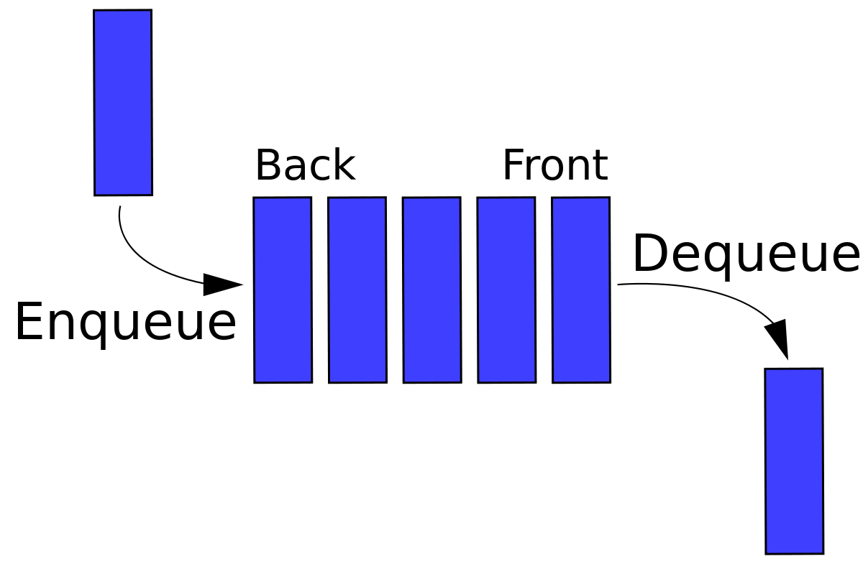
Concept: Queue
FIFO (First In, First Out) structure of elements
Of finite, pre-defined length
Has 2 ends: Front (head) and Back (tail)
Elements enter at Back – called Enqueue operation
Elements exit at Front – called Dequeue operation
Elements exit in the same order that they entered

Slide 24
Concept: Queue of function pointers
The nature of a Queue
Depends on its elements
What if a Queue’s elements are ‘function pointers’?
Enqueue operation
Put a function pointer into the queue’s tail
Dequeue operation
Get a function pointer from the queue’s head

Slide 25
Architecture: Function Queue Scheduling
FQS Concept:
Schedule using Queue of Functions
Queue elements are Function pointers
System with N devices
N task codes, handled by N functions, with same API/signature
void Service_Dev1(void);
void Service_DevN(void);
Define a function pointer
typedef void (*serv_func_ptr)(void); // new type, same API
Observe these statements
serv_func_ptr = &Service_Dev1; // points to Dev1 code
*serv_func_ptr(); // will run Dev1 code!
serv_func_ptr = &Service_DevN; // points to DevN code
*serv_func_ptr(); // will run DevN code!

Slide 26
FQS: Queue operations
Enqueue
Input is a function pointer
Sends this function pointer to the queue’s tail
void enqueue(serv_func_ptr in_function);
Usage
Put Service_Dev1()to the queue tail
enqueue(&Service_Dev1);
Dequeue
No input
Output is a function pointer from the queue’s head
serv_func_ptr dequeue(void);
Usage
Get the function out from the queue’s head
out_function = serv_func_ptr dequeue();
Call it by dereferencing the function pointer
*out_function();

Slide 27
FQS: Functioning
ISR code
Enqueue that Device’s Service function
To the queue’s tail
Main code
Keep dequeue’ing from the queue’s head
Obtain a function pointer
Dereference this function pointer
Run the corresponding service function

Slide 28
FQS: Code snippets
Interrupt code
Main code
void interrupt Handle_Dev1()
{
enqueue(&Service_Dev1);
}
…
void interrupt Handle_DevN ()
{
enqueue(&Service_DevN);
}
void Service_Dev1()
{
// Service Dev1
}
void Service_DevN()
{
// Service DevN
}
void main()
{
serv_func_ptr a;
while(1)
{
a = dequeue();
*a();
}
}

Slide 29
Architecture: FQS – study
Pros
Effect of FQS functioning
Service functions run in the same order they were qeueued up
Devices can be serviced more than once – no cycle concept
Dev1, Dev6, Dev4, Dev1, Dev1, … etc.
Cons
Devices with tendency to interrupt often
Are favoured with more service
Device with big/long service function
If queued and scheduled
Can hog up time and hold up the system

Slide 30
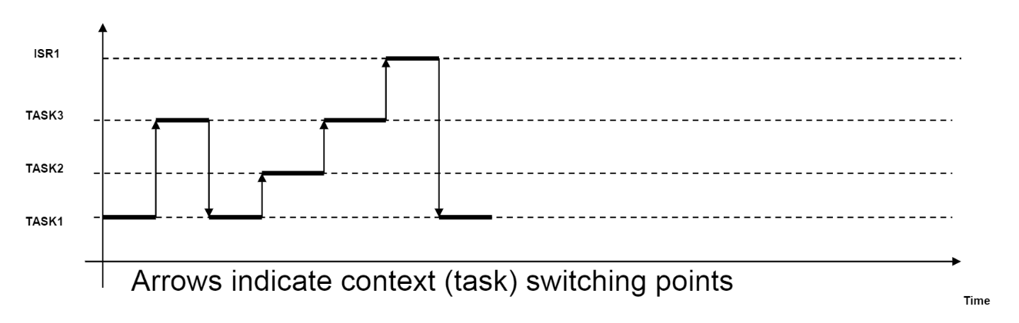
Architecture: RTOS
RTOS (Real-time operating system)
Executes service code functions as individual tasks
Tasks (could) have priority attributes
Provides task creation, deletion facilities
Runs a scheduler (usually part of kernel)
Decides the time sequence of tasks to run
Slices CPU time across multiple tasks
Switches tasks from slice to slice
Provides signaling services
Send(), Wait()

Slide 31
RTOS: Partitioning and Concepts
Code partitioned into:
ISR code
Service code (called Task code)
Main code
ISR code
Send a unique signal (per device)
Task code
Wait for device-unique signal
Run the device code
Main code
Initialize system
Start all tasks
Concepts
Task
A concurrent activity
Has its own thread of control
With its own stack, context, etc.
Semaphore
An inter-task communication mechanism for synchronization
A mechanism to keep track of resource usage
Mutex
A locking mechanism to resolve
Conflicting requests from different tasks
For the same resource

Slide 32
RTOS: Code snippets
Interrupt code
Main and task code
void interrupt Handle_Dev1()
{
Send_Signal1();
}
…
void interrupt Handle_DevN()
{
Send_SignalN();
}
void Task1()
{
Wait_for_Signal1();
Service_Device1();
}
void TaskN()
{
Wait_for_SignalN();
Service_DeviceN();
}
void main(void)
{
// Start Task1
…
// Start TaskN
}

Slide 33
Architecture: Comparisons
 | Priorities | WCRT | Stability to code changes | Complexity
Round-robin | None | Sum of all task codes | Very poor | Very simple
Round-robin w/interrupts | ISR, all tasks at same priority | Sum of all task codes + ISR times | Poor, lot of tuning needed | Shared data problem, ISR writing
Function Queue Scheduling | ISR, tasks in priority order | Time of longest task code + ISR times | Queue management is critical | Shared data problem, Queue code
RTOS | ISR, tasks in priority order | 0 + ISR time | Very good | High (needs kernel)

Slide 34
Thank you!

